Slide 1
Innovative Models of Geriatric Mental Health Services in Long Term Care: A Model Utilizing a Large Multi-Disciplinary Group
Senior PsychCare Leaders in the Mental Health of Seniors

Slide 2
I. Introduction II. Overview of SPC 2000-2008 / 2012-2013 III. Overview of Mental Healthcare in LTC VI. Management Issues V. Organizational Issues VI. Clinical Issues VII. Decision Making
Senior PsychCare Leaders in the Mental Health of Seniors

Slide 3
I. Introduction
Senior PsychCare Leaders in the Mental Health of Seniors

Slide 4
MediPsych in affliation with Senior Psychcare and Senior Psychological Care
Our Mission: A better quality of life for seniors, our staff and others
Our Vision: To be the leaders in mental healthcare of seniors
~Houston~Dallas~Fort Worth~San Antonio~Beaumont~Austin~

Slide 5
Sheppard Pratt
“FIND A NEED AND FILL IT”

Slide 6
Demographics of Behavioral Problems in Nursing Homes
Dementia in nursing homes was 58%, behavioral and psychological symptoms (BPSD) was 78%.
Major depressive disorder had a prevalence of 10% and prevalence was 29% for depressive symptoms.
Minimum data set that 46.5% dementia, 47% depression, 30% behavioral symptoms.

Slide 7
Psychiatric Care in Nursing Home: A Time for Consideration
From 1991 to 2005 of antidepressants paid rose 380%.
Psychotherapy and antidepressant treatment in combination may produce better outcomes.
From 1992 to 1995 use of psychotherapy for men decreased one-third.
Conclusion:
Less than 15% of residents in LTC receive adequate psychiatric and psychological care. This is less than 5% in rural areas.
5% of Psychotherapy provided by Psychiatrists

Slide 8
II. Overview of SPC 2000-2008, 2012-2013
Senior PsychCare Leaders in the Mental Health of Seniors
Best of Times
Worst of Times

Slide 9
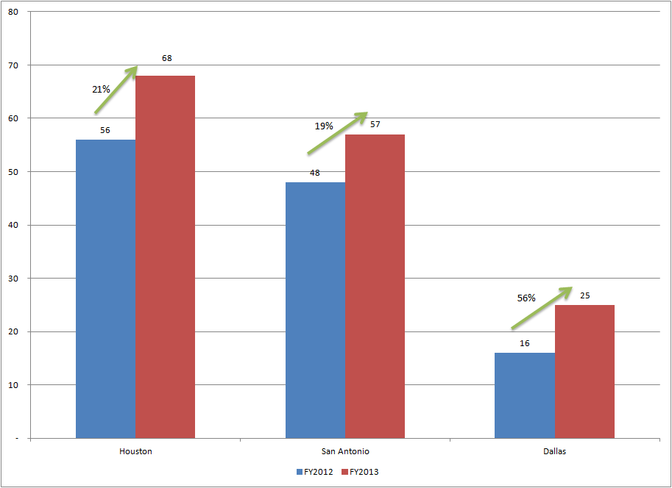

Slide 10
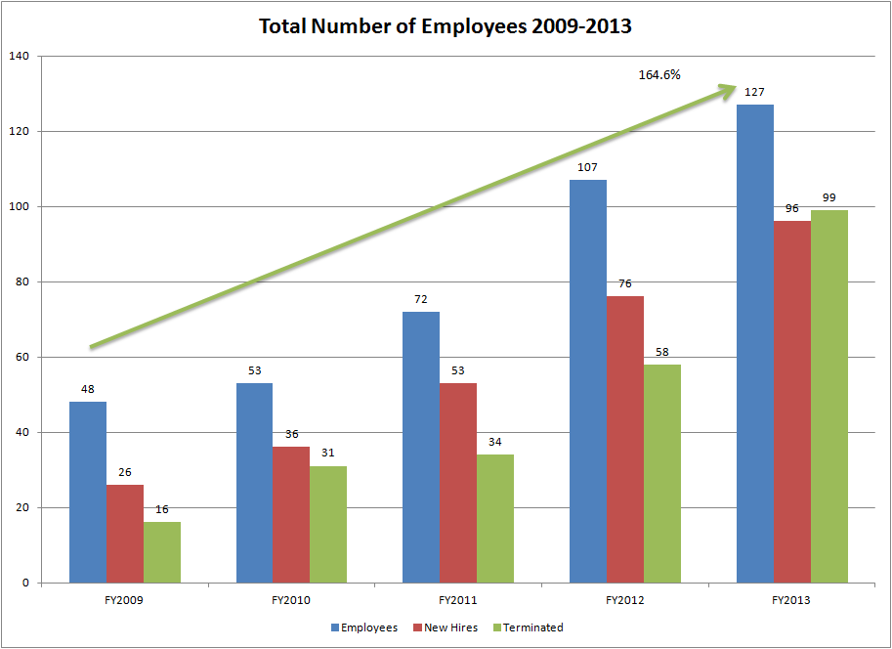

Slide 11
Milestones 2009-2010
+ Indicates Implemented
- Indicates Not implemented
Internal:
Group homes for developmental disabled +
Voluntary Compliance Programs +
CME Psychotherapy Program +
Reminiscent Validation/Namesta and Training +
Behavioral Modification and Problem Solving Therapy +
Group Therapy and Training+
External: Psychotherapy with Senior
Support groups for caregivers -
Alzheimer and Dementia Clinics -
Integrated senior mental health in primary care offices -
Management Consultation, coaching and mentoring -
Homecare for Seniors -
Balanced scoreboard in implementation: BCNI and VAM -
Senior PsychCare in affiliation with Senior Psychological Care
_{www.spchealth.com}

Slide 12
Milestones 2011 - 2014
2011
Revised Electronic Medical Record
Revised Psychotropic Medication Protocols of Management of Behavioral problems
Implement weekly Behavioral Rounds and Inservices
Voluntary Compliance Program
Family Therapy training
Recruit CEO
Medicare Fraud and Reimbursement Insurance
2012
Training for professionals on Psychotherapy
Reminiscent, Motivational, Interpersonal Psychotherapy, Dealing with Resistant Patients Training
Meaning Full Use
INC 5000 – Fastest Growing Company
2013
Problem Solving Therapy
Video Training for Nurse Practitioners in Geri-psychiatry – 35 hours
Recruit Clinical Coordinator of Psychotherapy
Appoint Regional Medical Directors
University of Texas School of Social Work Competition for Geriatric Mental Health Papers
Behavioral Rounds and Chart Rounds
Discontinued Quality of Life - a Homecare Program for Developmentally Impaired
2014
Becoming a Learning Organization
Training for Relationship Coordination to improve team functioning
Acquisitioning of Medical Groups Providing Ancillary Services
Assess Competency of Professional
Develop Outcome Measure
Negotiating Purchase of Primary Care Group in LTC
Telemedicine

Slide 13
III. Overview of
Senior PsychCare Leaders in the Mental Health of Seniors
Mental Healthcare
in LTC

Slide 14
Quality and Best Practices in Geriatric Psychiatric Services (President’s Commission on Aging)
1. A multidisciplinary team approach
2. Specific geriatric expertise and competence
3. Individualized assessment and treatment planning with
routine follow-up, ideally using standardized outcome
measures
4. Collaborative treatment planning between the
consultant and the nursing home staff (The most challenging)
5. A strong educational component (The second most challenging)
Senior PsychCare in affiliation with Senior Psychological Care
www.spchealth.com

Slide 15
The Different Type of Quality Psychiatric and Psychotherapy Care Model
(AAGP = The Role of Geriatric Psychiatrists in Nursing Homes, Volume 1, Issue 1)
1. Consultation Acceptable
2. Individual Provider Good
3. Team Approach Better
4. Integrated Comprehensive Best
and Mental Health Care
Education of Staff and
Involvement of Family
Senior PsychCare in affiliation with Senior Psychological Care
www.spchealth.com

Slide 16
IV. Management Issues:
Senior PsychCare Leaders in the Mental Health of Seniors
Teams, Leaders,
and Delivery of Services

Slide 17
Characteristics of Team Members: Belbin Team Member Profile
Type | Symbol | Typical Features | Positive Qualities | Allowable Weaknesses
Company Worker | CW | Conservative, dutiful, predictable. | Organizing ability, practical common sense, hard-working, self-discipline. | Lack of flexibility, unresponsiveness to unproven ideas
Chairman | CH | Calm, self-confident, controlled | A capacity for treating and welcoming all potential contributors on their merits and without prejudice. A strong sense of objectives. | No more than ordinary in terms of intellect or creative ability
Shaper | SH | Highly strung, outgoing, dynamic | Drive and readiness to challenge inertia, ineffectiveness, complacency or self-deception | Proneness to provocation, irritation and impatience
Plant | PL | Individualistic, serious-minded, unorthodox. | Genius, imagination, intellect, knowledge. | Up in the clouds, inclined to disregard practical details or protocol
Resource Investigator | RI | Extroverted, enthusiastic, curious, communicative. | A capacity for contacting people and exploring anything new. An ability to respond to challenge | Liable to lose interest once the initial fascination has passed.
Monitor- Evaluator | ME | Sober, unemotional, prudent | Judgment, discretion, hard-headedness | Lacks inspiration or the ability to motivate others
Team Worker | TW | Socially orientated, rather mild, sensitive | An ability to respond to people and to situations, and to promote team spirit | Indecisiveness at moments of crisis.
Completer- Finisher | CF | Painstaking, orderly, conscientious, anxious. | A capacity for follow-through. Perfectionism. | A tendency to worry about small things. A reluctance to ‘let go’.
Senior PsychCare in affiliation with Senior Psychological Care
www.spchealth.com

Slide 18
Leo Borrell – Belbin Profile
 | Name: Leo Borrell
 | Least Preferred Roles | Manageable Roles | Preferred Roles | Roles and Descriptions
 |  |  |  | Team - Role Contribution |  | Allowable Weaknesses
 | 0 10 20 | 30 40 50 60 | 70 80 90 100
PL |  |  | X | Plant | Creative, Imaginative, unorthodox. Solves difficult problems. | Ignores incidentals. Too pre-occupied with own thoughts to communicate effectively.
RI |  |  | X | Resource Investigator | Extrover, enthusistic, communicative, Explores opportunities. Develops contacts. | Over-optimistic. Can lose interest once initial enthusiasm has passed.
CO | X |  |  | Co-ordinator | Mature, confident, Clarifies goals. Brings other people together to promote team discussions. | Can be seen as manuipulative. Offloads personal work.
SH |  |  | X | Shaper | Challenging, dynamic, thrives on pressure. Has the rive and courage to overcome obstacles. | Prone to provocation. Liable to offend others.
ME |  | X |  | Monitor Evaluator | Serious minded, strategic and discerning. Sess all options. Judges accurately | Can lack drive and ability to inspire others.
TW | X |  |  | Teamworker | Co-operative , mild, perceptive and diplomatic. Listens, builds, averts friction. | Indecisive in crunch situations.
IMP | X |  |  | Implementor | Disciplined, reliable, conservative in habits. A capacity for taking practical steps and actions. | Somewhat inflexible. Slow to respond to new possibilities.
CF | X |  |  | Completer Finisher | Painstaking, conscientious, anxious. Searches out errors and omissions. Delivers on time. | Inclined to worry unduly. Reluctant to let owther into own job.
SP |  | X |  | Specialist | Single-minded, self-starting, dedicated. Provides knowledge and skills in rare supply. | Contributes on only a limited front. Dwells on specialized personal interests.

Slide 19
I. Versatile Leadership
Most Doctors are lopsided leaders – They Only Use Their Strengths
Leadership Definitions:
I Forceful Leadership |  | Enabling Leadership
Virtues | Taken to an extreme | Virtues | Taken to an extreme
Takes charge3!.in control of his/her unit. | Dominant to the point of eclipsing subordinates . | Empowers subordinates to run their own units. Able to let go. | Empowers to a fault. Gives people too much rope.
Lets people know clearly and with feeling where he/she stands. Declares himselflherself. | Other people don't speak out, aren't heard. | Interested in where other people stand. Receptive to their ideas. | People don't know where he/she stands.
Makes tough calls% including those that have an advHrse effect on people. | Insensitive, callous. | Compassionate. Responsive to people's needs and feelings. | Overly accommodating . Nice to people at the expense of the work .
Holds p13ople accountable-firm when they don't deliver. | Rigid; demoralizing. | Understanding when people are not able to deliver. | Tender-minded. Lets people off the hook.
Makes judgments. zeros | Harshly judgmental. | Shows appreciation. Makes | Gives false praise or
in on what is substandard or is not workin!gYiin an individual's or unit's performance . | Dismisses the contributions of others . | other people feel good about their contributions. Helps people feel valued. | praises indiscriminately .
Forces issues . Puts tough issues on the table even if it makes people uncomfortable . | Confrontational. Lacks finesse . Abrasive. | Fosters harmony, contains conflict, defuses tension . | Avoids conflict. Shies away from confronting performance problems.
Sure of himself/herself . Speaks authoritatively . | Hard for others to state their views. Arrogant. | Modest.Awarethat he/she does not know everything ; can be wrong . | Self-effacing. Self-deprecating.

Slide 20
II. Versatile Leadership

Slide 21
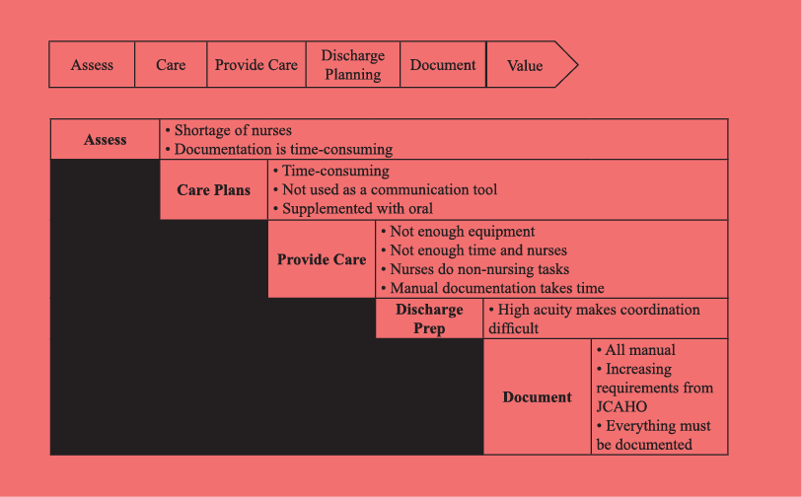
Healthcare Stakeholders Value Chain Understanding the Needs of Our Partners (The Nursing Home Staff)
Senior PsychCare in affiliation with Senior Psychological Care
www.spchealth.com

Slide 22
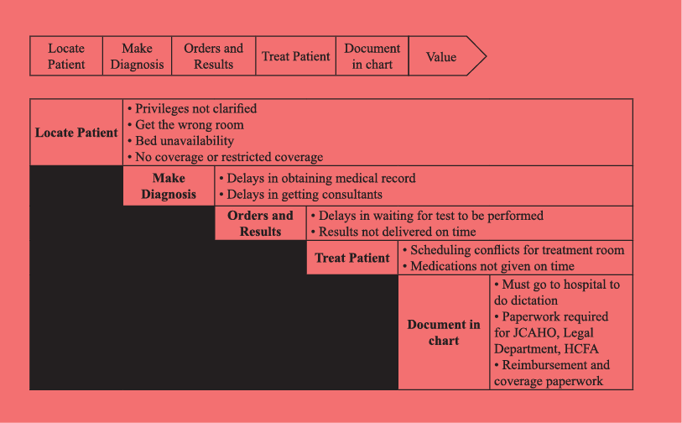
Healthcare Stakeholders Value Chain
Physician Value Chain
Senior PsychCare in affiliation with Senior Psychological Care
www.spchealth.com

Slide 23
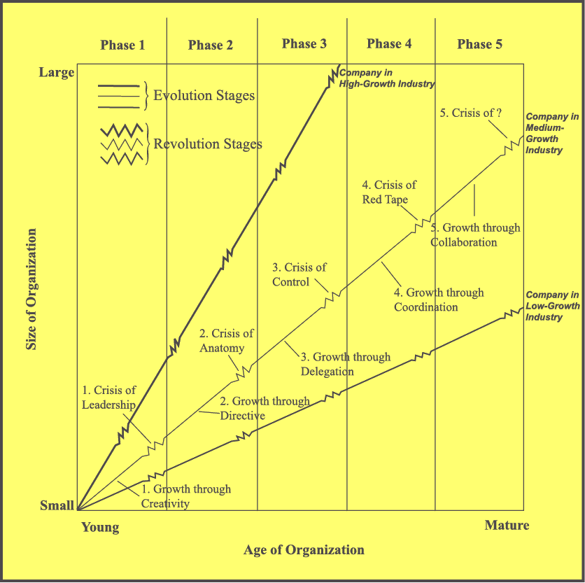
Barriers to Success: Rapid Growth Too Small to be Big, Too Big to be Small
Reference: Greiner. Evolution and Revolution is Organization’s Grow. HBR. 1980.
Senior PsychCare in affiliation with Senior Psychological Care
_{www.spchealth.com}

Slide 24
V. Organizational Issues
Senior PsychCare Leaders in the Mental Health of Seniors

Slide 25
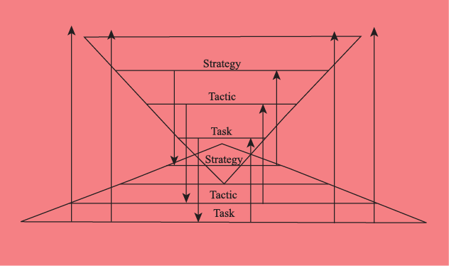
Barriers to Success: Communication Problems Organizationally that Interfere with Quality Care
Senior PsychCare in affiliation with Senior Psychological Care
_{www.spchealth.com}

Slide 26
Barriers to Success in Management: (lack of skills or knowledge) Understanding Organizational Issues in the Five Phases of Growth
Category | Phase 1 | Phase 2 | Phase 3 | Phase 4 | Phase 5
Organization Structure | Informal | Centralized & functional | Decentralized & geographical | Line-staff & product groups | Matrix of teams
Top Management Style | Individualistic & Entrepreneurial | Directive | Delegative | Watchdog | Participative
Management Reward Emphasis | Ownership | Salary & merit increases | Individual bonus | Profit sharing & stock options | Team bonus
 | Small or Individual Group Practice |  | Large Group Practice | Corporations
* Based on the Belbin Theory of Team Roles
Senior PsychCare in affiliation with Senior Psychological Care
_{www.spchealth.com}

Slide 27
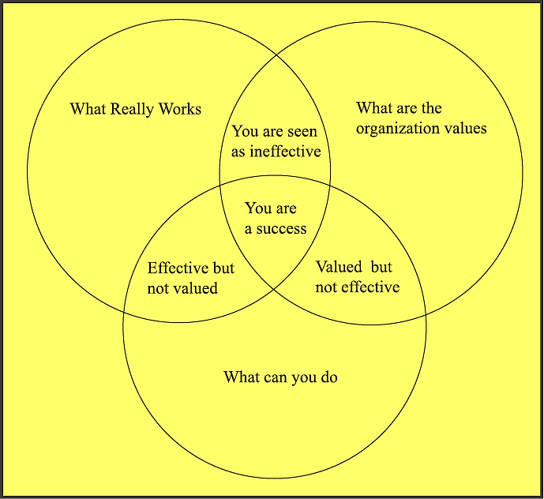
Barriers to Success: Conflicts Between and Among Managers - Affects Perception of Problems and Performance
Practical
Idealistic
Realistic
Senior PsychCare in affiliation with Senior Psychological Care
www.spchealth.com

Slide 28
BARRIERS TO SUCCESS: Change and Resistance to Change, Persist Because of Isolation and Avoid Discussion of Emotion and Loss Fast growing companies – things will never stay the same
_{Action}
_{(Prochaska)}
_{Self Perceived Competence}
2. Denial of change
Temporary retreat
Emphasize old competencies
3. “Incompetence”
Awareness that change is necessary
Not sure how to deal with it
Frustration
Depression
7. Integration
Incorporate new
ways into values,
beliefs to become
automatic through
practice
_{Precontemplation}
_{(Prochaska)}
6. Internalize
Quiet and reflective
Seek meaning and
understanding
_{Contemplation}
_{(Prochaska)}
Immobilization
Shock, disbelief, guilt
Mismatch of
Expectation and “new reality”
4. Acceptance
of “new reality”
Letting go of past
Relief
Tentative movement
5. Testing
New behaviors
New approaches
Stereotyped
“shoulds”
Start of Change
_{Cognitive Process}
_{Accomodation (Piaget)}
_{Assimilation (Piaget)}
Time
Senior PsychCare in affiliation with Senior Psychological Care
_{www.spchealth.com}

Slide 29
What it Takes to Change and Address the Different Phases of Growth
Pressure
for Change
Shared
Driven Vision
Capacity for Focused Change
Actionable
First
Steps
+
+
+
= Successful Change
Senior PsychCare in affiliation with Senior Psychological Care
_{www.spchealth.com}

Slide 30
Why We Fail In Management of Change:
+
Shared
Driven Vision
+
Capacity for Focused Change
Actionable
First
Steps
+
= Bottom of the “in box” Low Priority Project
(good idea, but I don’t agree)
Pressure for Change
+
+
Capacity for Focused Change
Actionable
First
Steps
+
= A Fast Start That Fizzles Directionless
(Energetic, no follow through, lack of a champion, project leader)
Pressure for Change
+
Shared
Driven Vision
+
Actionable
First
Steps
= Anxiety, Frustration, Loss of Competitive Edge
(Limited resources: time, money and people) S=Q²RT
+
Pressure for Change
+
Shared
Driven Vision
+
Capacity for Focused Change
+
= Haphazard Efforts, False Starts, Uncoordinated
(No planning or coordination or rewards to achieve
goals)
Senior Psychcare Care in affiliation with Senior Psychological Care
www.spchealth.com

Slide 31
VI. Clinical Issues in LTC
Senior PsychCare Leaders in the Mental Health of Seniors

Slide 32
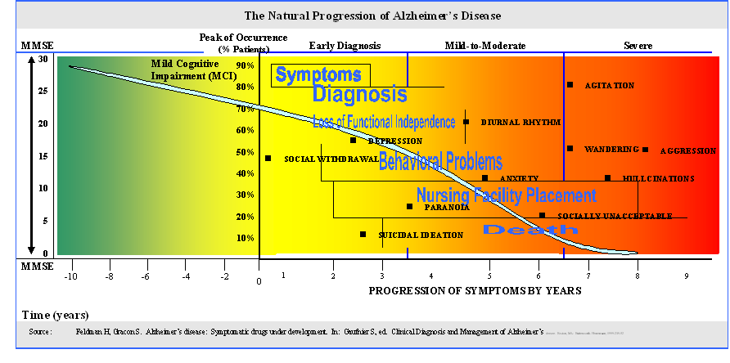
Solution 1: Know where you are: LJB:MGMT 101; if you can measure it you cant manage it Staff Professionals must use rating scales to monitor course of dementia and determine best intervention.
Senior PsychCare in affiliation with Senior Psychological Care
www.seniorpsychiatry.com

Slide 33
PSYCHOTHERAPIES (that are effective in Seniors)
DIFFERENT STROKES FOR DIFFERENT FOLKS
 | Focus of Intervention | Specific Techniques
Cognitive-Behavioral Therapy (CBT) | Maladaptive thoughts and behaviors | Self-monitoring, increasing participation in pleasant events, challenging negative thoughts and assumptions
Interpersonal Therapy (IPT) | Unresolved grief, interpersonal disputes, role transitions, skills deficits | Exploration of affect behavior change techniques, reality testing of perceptions
Problem-Solving Therapy (PST) | Problem-solving skills | Identifying specific problems; brainstorming, evaluating, implementing and reviewing solutions
Brief Psychodynamic Therapy | Lack of insight, relationship problems | Analyzing current problems in light of historical patterns, using the therapeutic relationship identify issues and practice new ways of relating to others
Life Review / Reminiscent / Validation | Integration of past and present experiences | Structures reminiscence, constructive reappraisal of the past, recollection of previously used coping strategies
Dialectical Behavior Therapy (DBT) | Negative affect, impulsivity, suicidal thoughts and gestures, interpersonal skills deficits | Increasing mindfulness, distress tolerance, emotion regulation, interpersonal effectiveness skills
Family Therapy | Past and current family issues | Psychoeducation of patient and family, assessment of relationship difficulties, behavioral prescriptions
Caregiver Interventions | Stress and burden | Emotional support, encouragement of help-seeking and self-care, information about community resources, may include CBT and PST elements

Slide 34
Alzheimer’s and Dementia are Not Waiting
If You Don’t Know There is a Problem
You Can’t Provide a Solution
Only 44% of psychiatrists inform patients
56% of professionals in memory clinics disclose diagnosis
75% of geriatricians and geriatric psychiatrists disclose AD or Dementia
Stage of dementia, difficult to predict - progression symptoms
50% of practitioners do not disclose dementia diagnosis, therefore proper treatment is not provided
30% of dementia problems related to speech , hearing, pain
Senior PsychCare in affiliation with Senior Psychological Care
www.spchealth.com

Slide 35
Benefits of Behavioral Rounds Services by SPC Reduction of Psychotropic Medications
Senior PsychCare Leaders in the Mental Health of Seniors
48% of the patients seen have had a reduction or change in medication
Medication:
Typical Antipsychotic .66%
Atypical Antipsychotic 15.18
Mood Stabilizers 5.28%
Anti-depressant 22.44%
Anti-anxiety/benzo 30.36
Anti-dementia 23%

Slide 36
The Benefits of Value Care
Management of Aggressive Behavior (requires an MD to coordinate and review care periodically and meet with nursing homes staff to have input of their interventions- “The 4 R’s) | Cost Savings Per Year
Utilizing medications and psychotherapy requires appropriate diagnosis and restorative potential and complexity of decision making | $3500/year
Utilizing Depakote rather than atypical antipsychotics – doesn’t hit quality indicators | $2500/year
Maintaining a use of Donepezil and Namenda for cognitive and social symptoms | $2500/year
Total Cost Savings Per Patient Per Year | $8500/year
Cost of Management of Aggressive/Agitated Patient | $10,000/year
Senior PsychCare in affiliation with Senior Psychological Care
_{www.seniorpsychiatry.com}

Slide 37
What research shows about treatment of mental health problems in nursing homes
58% of those with depression alone, receiving the comprehensive intervention had recovered from their depression six months later and had a better quality of life; Results were comparable to Klerman’s original research on anti-depressants in 1980.
25% of those receiving un-supplemented general practitioner care decreased depression, but they did not have significantly better quality of life.
Without psychotherapy, individuals with depression or dementia or both:
20% continued to exhibit behavioral symptoms
40% exhibited physically and/or verbally aggressive behavior
The Maryland Assisted Living Study : “Prevalence, recognition, and treatment of dementia and other psychiatric disorders in the assisted living population of central Maryland, Journal of the American Geriatrics Society, 52: 1618-1625. London , R. “All-or-Nothing” Thinking and Psychiatry. Clinical Psychiatry News 2011;8

Slide 38
VII. Decision Making
Senior PsychCare Leaders in the Mental Health of Seniors

Slide 39
Theoretical Explanation for Mistakes of Managing Behavioral Problems Clinical (Miles) Mistakes in Logical Thinking: Common Fallacies in Medical Decisions (what)
The gambler’s fallacy: the human tendency to define outcomes in terms of good or bad luck, ignoring recency.
Occam’s razor: The human tendency to accept an obvious solution.
The cost-value illusion: The human tendency to equate value with cost.
The conjunction fallacy: The human tendency to assume sensible outcomes of compound gambles incorrectly, without measuring the reality of such compound gambles.
The omission-commission bias: the human tendency to select safe management options over superior but more risky options (under valued benefits, over valued risks).
The consumer-beneficiary complexity: The inability of all humans to simultaneously consider the multiple factors involved in cost-benefit analyses.
The metaphor-context complexity: The application of a good solution or schematic in an inappropriate context.
Reference:
Miles, Richard W. Fallacious Reasoning and Complexity as Root Causes of Clinical Inertia. AMDA July 2007. 8:6. 349-354.
Campbell A. Why Good Leaders Make Bad Decisions. Harvard Business Review. Feb. 2009.
Senior PsychCare in affiliation with Senior Psychological Care
_{www.spchealth.com}

Slide 40
Practical Reasons why we fail in management of Behavioral Problems Mistakes in Logical Thinking: Common Fallacies in Treating Chronic Diseases
Patient Factors and Underservice
Presence of multiple comorbidities
Low socioeconomic status
Advancing age
Feminine gender
Low medical literacy
Lack of access to health care
Patient non-adherence, non-compliance
Physician factors and Underservice
Clinical inertia
Fallacious reasoning
Ageism
The dual task theory
Tendencies to underestimate benefits of treatment
Tendencies to overestimate adverse effects of treatment
System factors and Underservice
System of compensation
Defensive medical record keeping
Lack of training to manage multiple comorbidities
Reference: Miles, Richard W. Fallacious Reasoning and Complexity as Root Causes of Clinical Inertia. AMDA July 2007. 8:6. 349-354.
Senior PsychCare in affiliation with Senior Psychological Care
_{www.spchealth.com}

Slide 41
Clinical Mistakes in Logical Thinking
A safe option is perceived as superior to a more risky option (Do not harm – acts of commission easier to identify than acts of omission
Compelling evidence not sufficient to change established belief.
Cognitive processes in diagnostic reasoning is different than in the planning treatment process (analytical verses providing structure)
Attitude change to deal with the emotional resistance of long held values requires assessment of personality and risk taking profile. The “more training and success that the practitioner has, the more resistance he has to recognizing fallacious beliefs.” Experience prevents being open-minded.
Evidenced-based Medicine” Rosenblatt, A, Samus, Q. M. , Steele, C.D, Baker, A.S. Harper, M.G. Brandt, J. Rabins, P.V. and Lykestsos, C.G. (2004), The Maryland Assisted Living Study : “Prevalence, recognition, and treatment of dementia and other psychiatric disorders in the assisted living population of central Maryland, Journal of the American Geriatrics Society, 52: 1618-1625. London , R. “All-or-Nothing” Thinking and Psychiatry. Clinical Psychiatry News 2011;8
Senior PsychCare in affiliation with Senior Psychological Care
_{www.spchealth.com}

Slide 42
Recommendation:
Senior PsychCare Leaders in the Mental Health of Seniors
Conclusion:
If you don’t know where you are going, you are not going to get there or know if you are there.
Reflect on your strengths and weaknesses to achieve your goals
Make a plan, type of practice you want, where you want to be in 1 – 3 – 5 years
Begin to develop a list of resources of people you need and that support your goals.
Review Handouts
Email: lborrellvc@hotmail.com
Website: www.seniorpsychiatry.com; www.alzheimersisnotwaiting.com; askb4ucallmd.com

